Slide 1
PRESENTED BY :-
HEMRAJ GUPTA

Slide 2
PROJECT - 1
SIMPLE CALCULATOR USING PYTHON

Slide 3
ABOUT THE PROJECT
A Calculator is basically a program on a computer that simulates the behavior of any hand – held calculator useful for performing mathematical calculations. It is a very basic device used in our everyday lives. Now all the smartphones also have a calculator application in them.
While creating any GUI Application there are mainly two steps :
The first step is to create a User interface.
The second step is the most important one and in this, to add functionalities to the GUI

Slide 4
Tools and Technologies
Tools - Python , Visual Studio
Python Libraries – tkinter, etc.

Slide 5
Tkinter
Tkinter is the standard GUI library for Python. Python when combined with tkinter provides a fast and easy way to create GUI applications.
Tkinter provides a powerful object – oriented interface to the Tk GUI toolkit.

Slide 6
Visual Studio
Visual Studio is a powerful developer tool that you can use to complete the entire development cycle in one place. It is a comprehensive integrated development environment (IDE) that you can use to write, edit, debug, and build code, and then deploy your app. Beyond code editing and debugging, Visual Studio includes compilers, code completion tools, source control, extensions, and many more features to enhance every stage of the software development process.

Slide 7
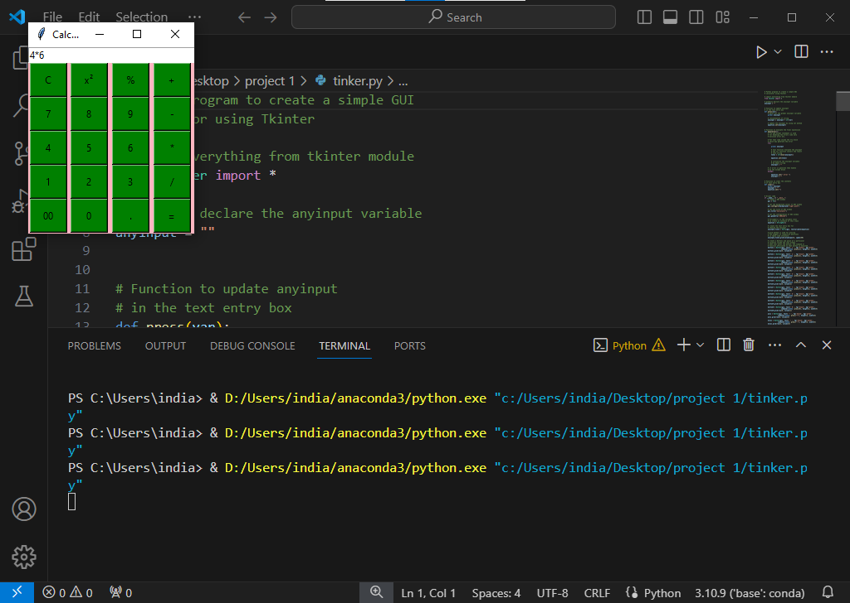
output

Slide 8
Thank you ..

